Slide 1
District Quarterly Update
Soil and Water Conservation Program
July 31, 2024 Jefferson City, MO

Slide 2
Welcome!
Welcome to the meeting, and thank you for taking a few minutes to join us.
In the interest of saving time, please allow us to go through our agenda and write down any questions you may have as we go. When we get to the end we will make time to answer questions.
Please make sure your phone or the microphone on the computer you are using is muted.

Slide 3
Program News
Updates from the Soil and Water Program:
Cost Share Totals: An overlook of cost-share performance for FY24 and projections for FY25.
Commission Meeting Update: A quick review of select items from the June 12th Commission meeting and the upcoming August 14th meeting.
Progression Line Update

Slide 4
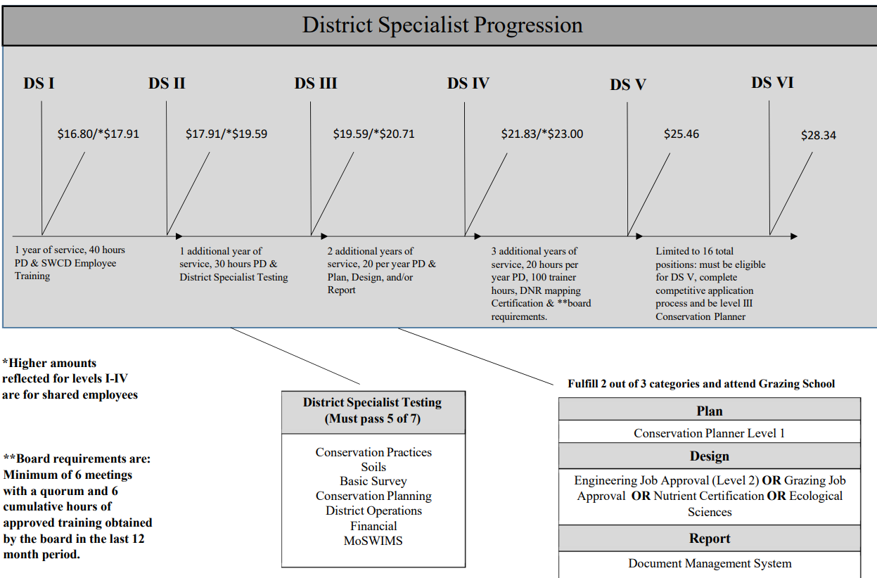
Progression Line

Slide 5
District Specialist VI
Application Period begins soon
Will fill 8 DSVI and 8 subsequent DSI positions
To apply send the following to soil&waterconservationprogram@swcd.mo.gov
Cover letter
Resume
Letter of Support from Board
Any other letters of recommendation or relevant documentation.
Candidates will be interviewed by a committee with representation from:
SWCP
NRCS
Association(s)

Slide 6
Performance Funding
$ Acres | $ Practice | $ Admin | $ Board | Max$ | Eligible $ |  | Not Claimed | % Claimed
$2,093.40 | $1,958.35 | $1,859.30 | $0.00 | $9,003.89 | $5,911.05 |  | $3,092.84 | 65.65
NO
92nd percentile
85th percentile
83rd percentile
$2,251 possible for each of 4 metrics.

Slide 7
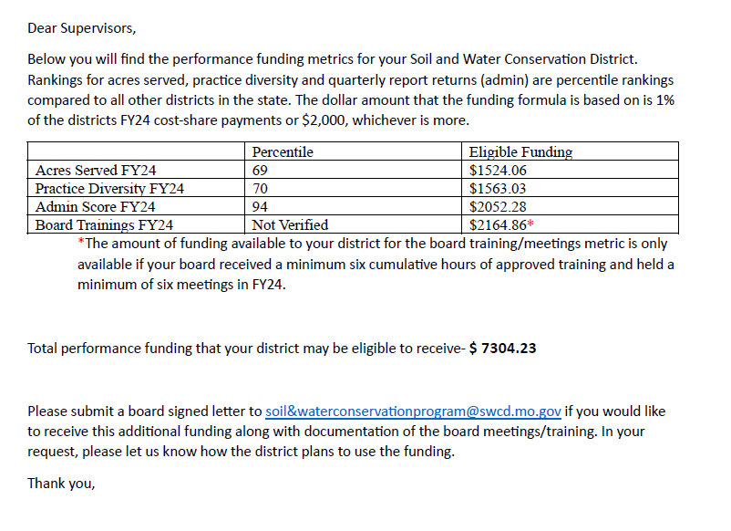

Slide 8
Practices and Policy Update
Dan Norwald and Justin Davis: DNR Well Plugging
Reminder of the drought executive order in effect until September 1, 2024.
Explaining possible changes coming to the N340 practice.

Slide 9
District Employee Spotlight
This is an opportunity to show our appreciation for our fellow employees who go above and beyond, displaying not only a knowledge of the job, but a willingness to help others along the way.
This quarter’s employee spotlight is: Rhonda Metcalf, Carroll County SWCD
Rhonda has been with Carroll County for 28 years. She has seen her fair share of changes through the program in that time, and is always quick to smile and lend a helping hand to other districts in the name of conservation. Whether it be in person or over the phone, you can always count on Rhonda to tell you straight and make sure the job gets done.
Please let your coordinator know if you have someone in your district you would like to nominate for the employee spotlight at the next update!

Slide 10
Questions
Any questions you may have for the items discussed or any other issue you would like to ask the program office about.
Thank you all for the amazing work you have done, and the service you continue to provide to your counties.

