Slide 1
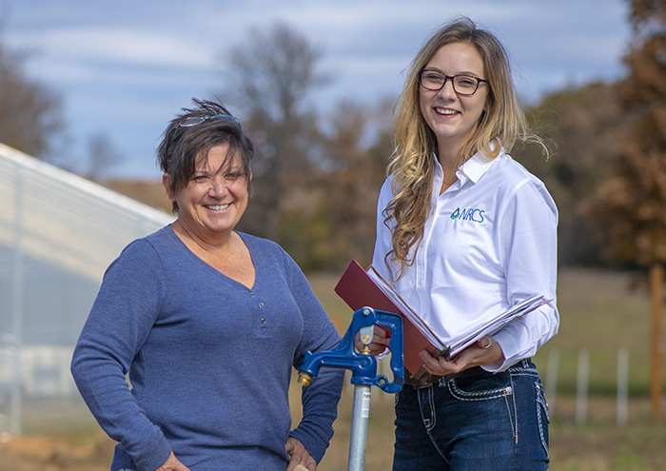
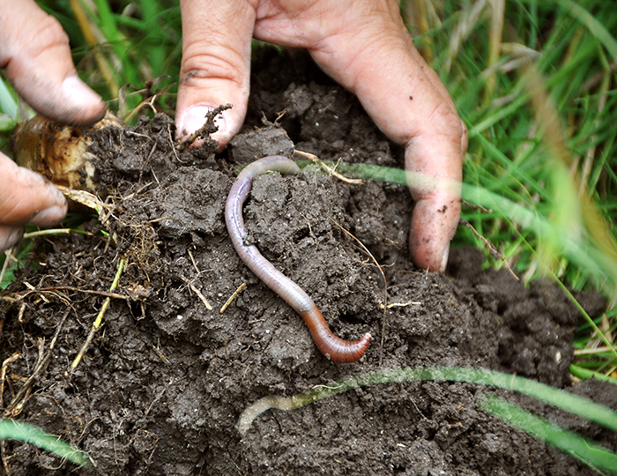
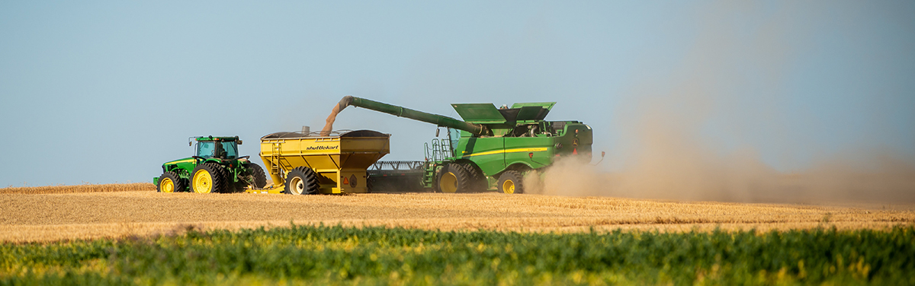
Update on Nutrient Management and Pest Management Conservation System Certifications

Slide 2
Update of NRCS Certification Process
Level II Technical Specialist Certification is no longer an option
CNMP remains a separate (stand alone) specialty certification
Ecological Sciences Job Approval Authority (ESJAA) is now being utilized in place of the previous certification for nutrient and pest management
MO Supplement to General Manual (GM) 180 Part 409 will be updated to removed the state specific certifications for nutrient and pest management

Slide 3
How do I get certified in Nutrient Management (590); Formal Process
CPS 590 MO OTH Nutrient Management 2024
Provides information regarding the Nutrient controlling factor
There are four job classes (I, II, III, IV)
Commercial fertilizer only
Commercial fertilizer, manure, compost, and other organic nutrient sources
Precision Agricultural Technology
All
ESJAA approval level has three different categories:
Inventory and Evaluation (I&E)
Design and Development
Installation/Checkout

Slide 4
How do I get certified in Nutrient Management (590); Formal Process
CPS 590 MO OTH Nutrient Management 2024 continued:
Courses and plan development requirement – Knowledge, Skills, and Abilities (KSA) are provided for:
I&E and Installation/Checkout
Design and Development
Tracking form

Slide 5
I was certified but it was pulled; what now?
CPS 590 MO OTH Nutrient Management 2024
Refer to the KSAs and the courses required
Determine what Job Class level you would meet for I&E and Installation/Checkout
If wanting to meet Design and Development, additional courses/requirements may be needed such as providing a plan.
Provide certificates for courses completed
Tracking form

Slide 6
How do I get certified in Pest Management Conservation System (595); Formal Process
CPS 595 MO OTH Pest Management Conservation System 2024
Provides information regarding the two controlling factors
Pesticide Loss Pathways Addressed
Land Use
There are five job classes (I, II, III, IV, V) for each controlling factor
Pesticide Loss Pathways Addressed – Drift; Drift and Surface Runoff; Drift, Surface Runoff and Leaching to Groundwater; Drift, Surface Runoff, Leaching to Groundwater, and Beneficial Organisms; All
Land Use – Pasture/Range land, Forest, Standard Row Crops, Specialty/Vegetable Crops, Organic Crops/Orchard/Vineyards

Slide 7
How do I get certified in Pest Management Conservation System (595); Formal Process
CPS 595 MO OTH Pest Management Conservation System 2024 continued:
ESJAA approval level has three different categories for each controlling factor (approval is needed under both factors)
Inventory and Evaluation (I&E), Design and Development, Installation/Checkout
Controlling factors do not have to be at same Job Class level

Slide 8
How do I get certified in Pest Management Conservation Practice (595); Formal Process
CPS 595 MO OTH Pest Management Conservation System 2024 continued:
Courses and plan development requirement – Knowledge, Skills, and Abilities (KSA) are provided for:
I&E and Installation/Checkout
Design and Development
Tracking form

Slide 9
I was certified but it was pulled; what now?
CPS 595 MO OTH Pest Management Conservation System 2024
Due to the significant changes to the PMCS standard in 2021, prior certifications do not fully meet
Determine what Job Class levels you would meet for I&E and Installation/Checkout
In-person course will be required for all staff/partners seeking certification/recertification for Design and Development
Provide certificates for courses completed
Tracking form

Slide 10
All I need is in-person trainings, are those available, and how do I get access?
NM and PM courses are being planned for 2025
Work with the local District Conservationist (DC) to be added to the Data Call list
Seats are available for partner staff
NOTE: You can still develop a plan, but it will need to be approved by a staff member that already has earned ESJAA for Design and Development for the appropriate Job Class Level(s).

Slide 11
Is there backlog on reviewing plans? How long should I wait to hear back?
Yes, there is a backlog of NM and PM plan reviews
We are working through this and continue to plan training to get more staff certified.
Certification process for Area NM or PMCS designated planners is in process
Contact Area Resource Conservationist (ARC) or Area Soil Health Specialist (SHS)

Slide 12
QUESTIONS
USDA is an Equal Opportunity Employer, Provider, and Lender

