Slide 1
Missouri Workshop on Native Pollinators
J.R. Flores, State Conservationist
Dwaine Gelnar, State Resource Conservationist

Slide 2
What is NRCS doing to protect pollinators?
2008 Farm Bill prioritizes pollinators and their habitat.
2008 Farm Bill authorizes the Secretary of Agriculture to encourage “the development of habitat for native and managed pollinators; and the use of conservation practices that encourage native and managed pollinators”.
USDA NRCS incorporation into practices and programs

Slide 3
What is NRCS doing to protect pollinators?
NRCS in Missouri provides technical and financial assistance to farmers and landowners to help them plan and implement conservation systems that conserve and create habitat for pollinators using existing programs and practices. These systems include individual practices that can help pollinators survive and thrive, providing pollen and nectar (increased nutrition) for bees and other pollinators or protection from pesticides.

Slide 4
Natural Resources Conservation Service
Conservation Practice Standard
Conservation Cover
(Ac.)
Code 327
DEFINITION
Establishing and maintaining permanent vegetative cover
PURPOSE
This practice may be applied to accomplish one or more of the following:
Reduce soil erosion and sedimentation.
Improve water quality.
Improve air quality
Enhance wildlife habitat and pollinator habitat.
Improve soil quality
Manage plant pests

Slide 6
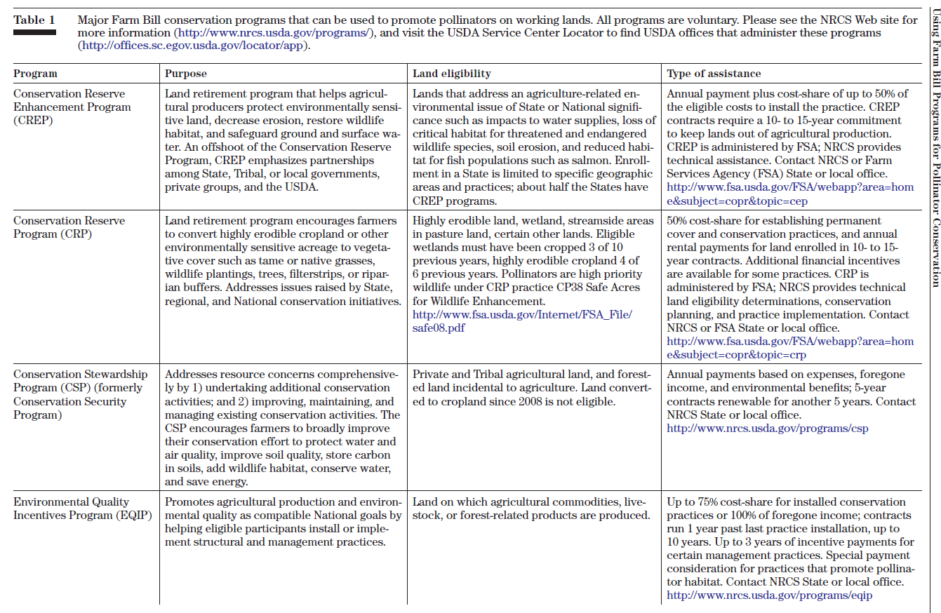

Slide 7
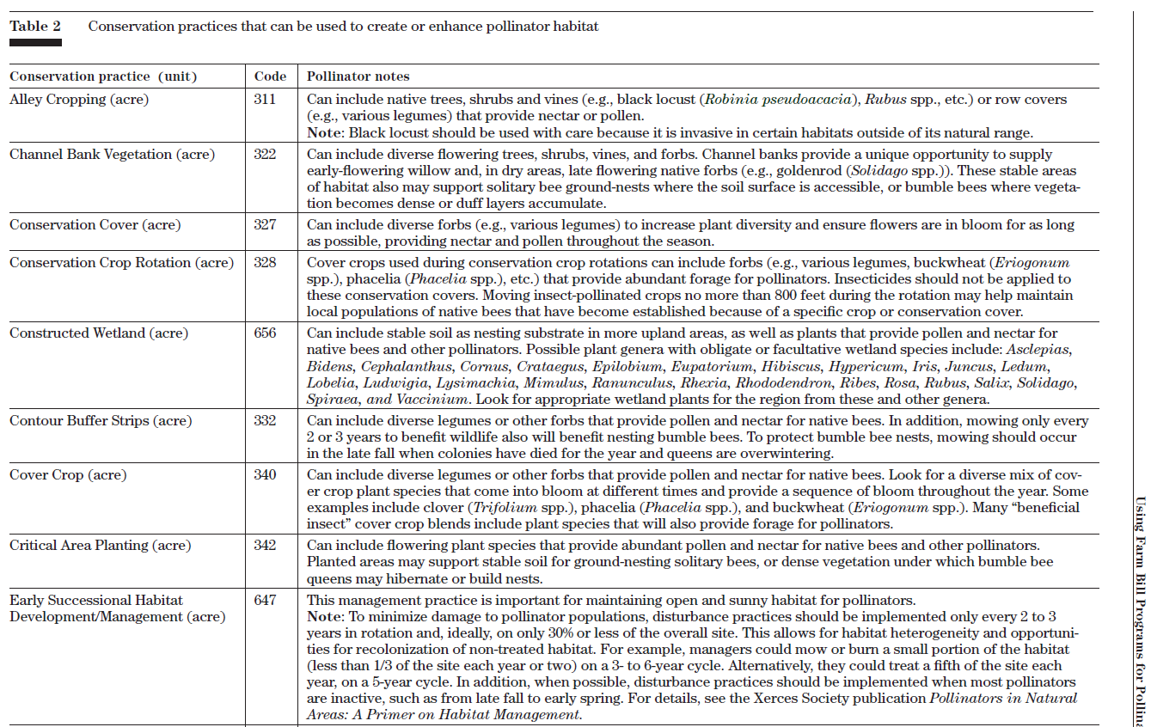

Slide 8
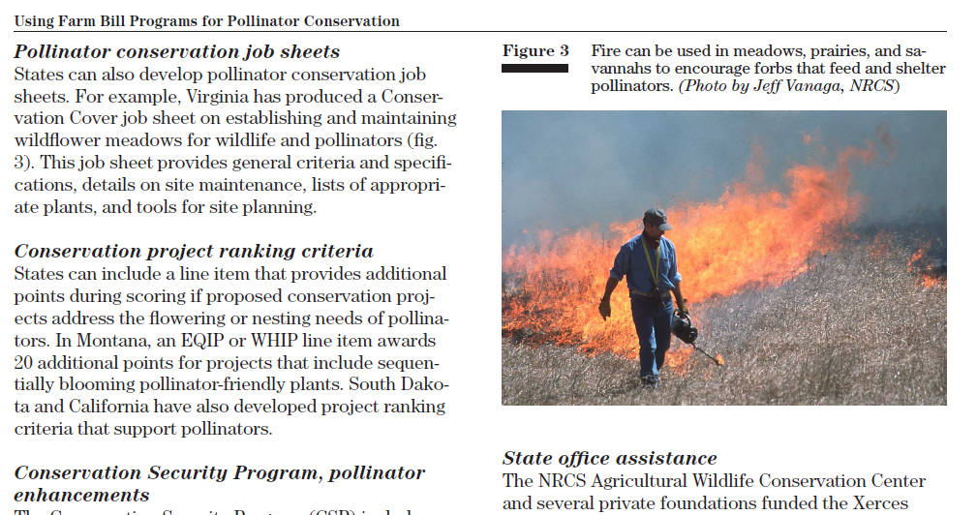

Slide 9
 |  | 2010 |  |  | 2011
Practice Code | Practice Name | Con-tracts | Practice Count | Practice Amount | Con-tracts | Practice Count | Practice Amount
327 | Conservation Cover |  | 67 | 692 |  | 42 | 359
386 | Field Border |  | 6 | 60 |  | 7 | 10
645 | Upland Wildlife Habitat Management |  | 327 | 2,371 |  | 201 | 1,700
647 | Early Successional Habitat Development/Management |  | 24 | 44 |  | 2 | 11
TOTAL |  | 225 | 424 | 3,167 | 150 | 252 | 2,079
 |  | 2012 |  |  | Total For All Years
Practice Code | Practice Name | Con-tracts | Practice Count | Practice Amount | Con-tracts | Practice Count | Practice Amount
327 | Conservation Cover |  | 26 | 121 |  | 135 | 1,172
386 | Field Border |  | 1 | 2 |  | 14 | 71
645 | Upland Wildlife Habitat Management |  | 60 | 613 |  | 588 | 4,685
647 | Early Successional Habitat Development/Management |  | 0 | 0 |  | 26 | 55
TOTAL |  | 63 | 87 | 737 | 438 | 763 | 5,983

Slide 10
EQIP Financial Assistance
For Pollinators
2010 – 2012
Contract Year | Contracts | Acres Planned | Obligation Amount | Completed Payments
2011 - 2012 | 1,854 | 79,090 | $3,773,950 | $1,890,187
2010 | 428 | 13,054 | $700,524 | $563,402
2011 | 549 | 26,862 | $1,261,311 | $768,358
2012 | 877 | 39,175 | $1,812,115 | $558,427

Slide 11
EQIP Financial Assistance For Pollinators
2010 – 2012
Code | Practice | Acres | Obligated Dollars
327 | Conservation Cover | 1,172 | $ 200,000
338 | Prescribed Burning | 7,000 | $ 400,000
340 | Cover Crop | 55,000 | $ 2,500,000
386 | Field Border | 71 | < $100,000
643 | Restoration and Management of Rare and Declining Habitats | 9,900 | $ 300,000
645 | Upland Wildlife Habitat Management | 4,685 | $ 700,000
647 | Early Successional Habitat Development/Management | 55 | < $100,000

Slide 12
EQIP Financial Assistance For Pollinators
2013

Slide 13
EQIP Financial Assistance For Pollinators
2013

Slide 14
EQIP Financial Assistance For Pollinators
2013
Pollinator Habitat Enhancement Plan
A pollinator habitat enhancement plan is a site-specific conservation plan developed for a client that addresses the improvement, restoration, enhancement, or expansion of flower-rich habitat that supports native and/or managed pollinators.

Slide 18
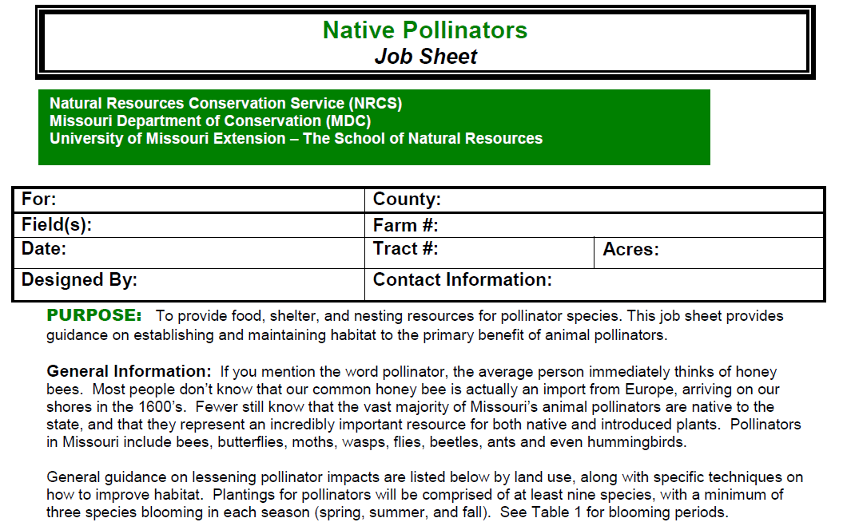

Slide 20
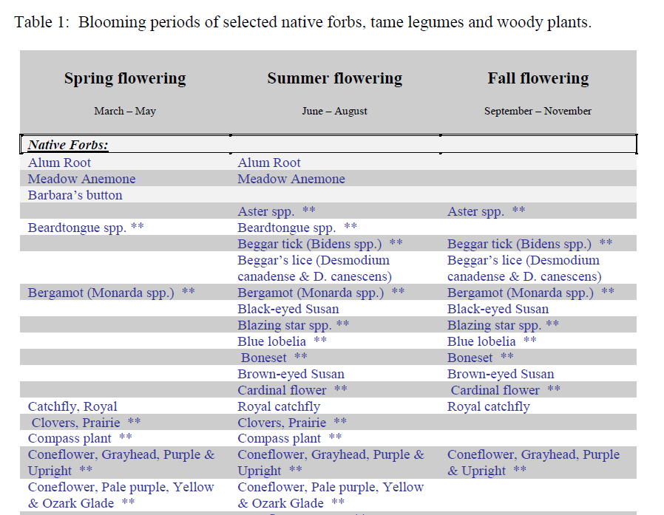

Slide 21
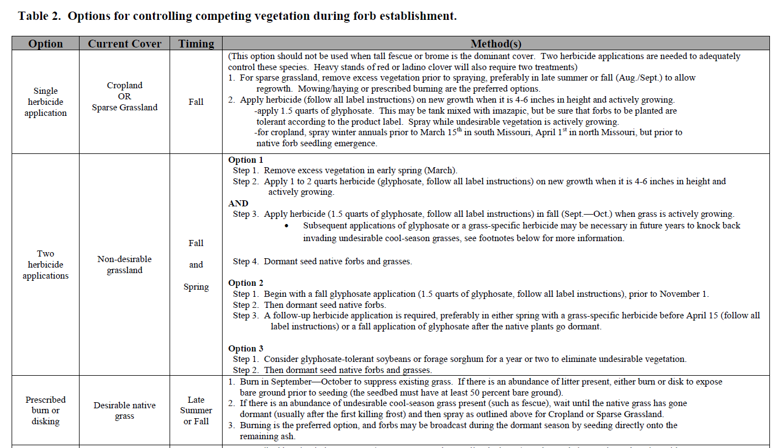

Slide 22
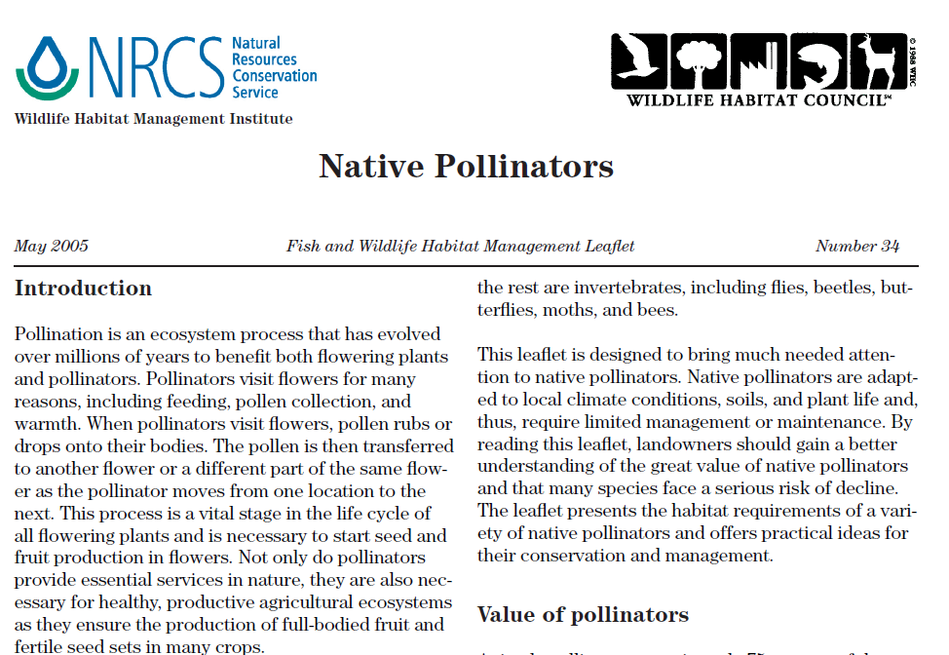

Slide 23
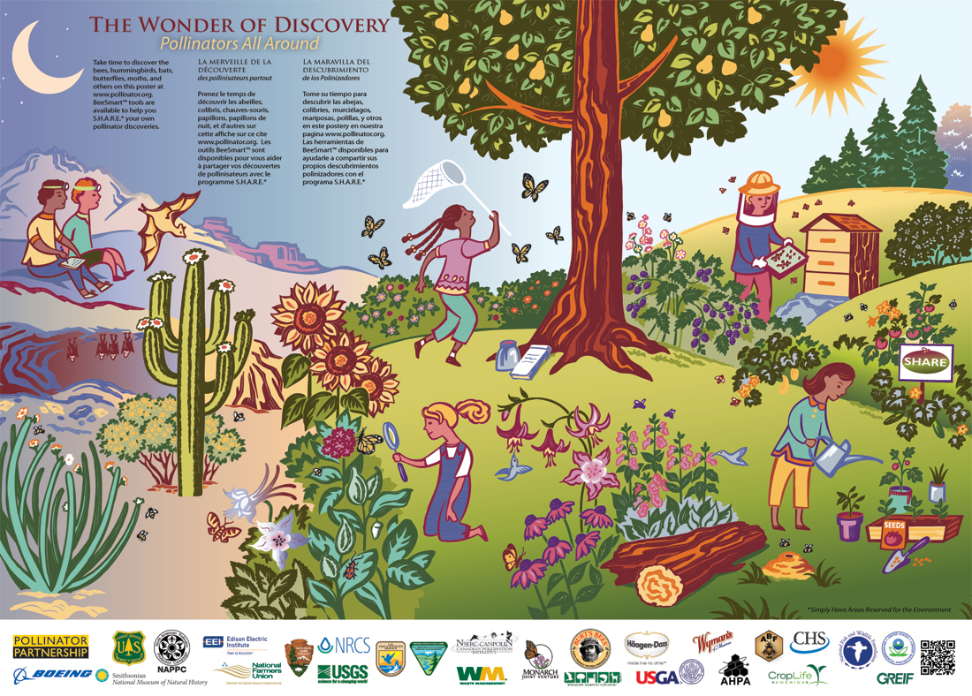

Slide 24
The U.S. Department of Agriculture (USDA) prohibits discrimination in all its programs and activities on the basis of race, color, national origin, age, disability, and where applicable, sex, marital status, familial status, parental status, religion, sexual orientation, genetic information, political beliefs, reprisal, or because all or a part of an individual's income is derived from any public assistance program. (Not all prohibited bases apply to all programs.) Persons with disabilities who require alternative means for communication of program information (Braille, large print, audiotape, etc.) should contact USDA's TARGET Center at (202) 720-2600 (voice and TDD). To file a complaint of discrimination write to USDA, Director, Office of Civil Rights, 1400 Independence Avenue, S.W., Washington, D.C. 20250-9410 or call (800) 795-3272 (voice) or (202) 720-6382 (TDD). USDA is an equal opportunity provider and employer.

